Slide 1
ERAU ASCEND 2021 Arizona space Grant symposium | April 17, 2021

Slide 2
TEAM
Members
Nicodemus Phaklides – Team Lead
Zach Howe – Integration Lead
Michael Lauber – Structures Lead
Mentor
Dr. Douglas Isenberg

Slide 3
Payload Overview
Goals:
Study heat transfer within a high-altitude balloon payload
Develop a thermally stable, modular system that future experiments can be based on
Resolve attitude and position for the payload in flight
Record video of flight

Slide 4
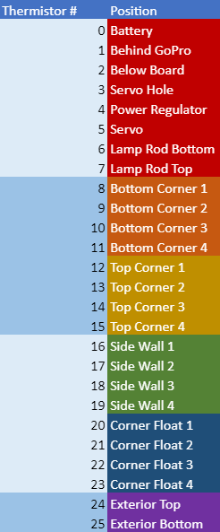
HEAT TRANSFER Experiment
26 thermistors are used to measure temperature around the craft
Two temperature sensors on the board
IMU and Altimeter
13
12
16
9
8
21
4
20
5
3
0
2
24
19
17
6
7
25
23
22
1
10
18
11
14
15

Slide 5
ADDITIONAL EXPERIMENTS
Position Resolution:
Adafruit MTK3339 GPS
Adafruit MPL3115A2 Barometric Altimeter
Attitude Resolution:
Adafruit BNO055 Absolute Orientation IMU
External Solar Panels routed into ADC
A GoPro will be used to record video of the flight

Slide 6
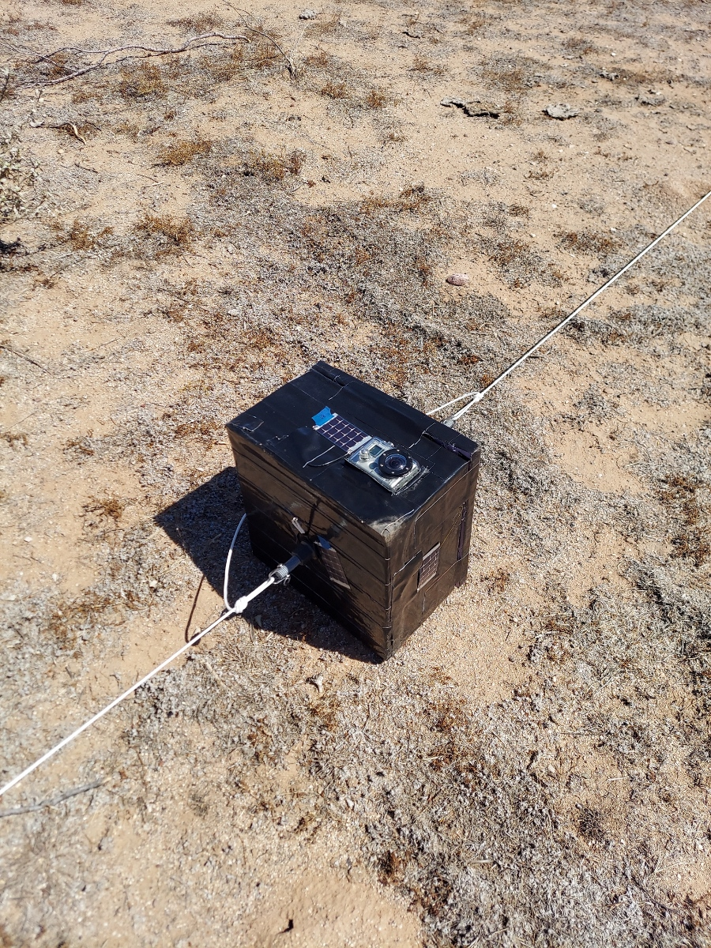
Results
Failures:
GoPro battery was not charged enough to record inflight video
Microcontroller rebooted 3 times in flight
57,000ft - peak - 46,000ft, 43,000ft – 24,000ft, 1,600ft
GPS could not achieve lock until landed
Successes:
Heat transfer experiment recorded excellent data
IMU and Altimeter data recorded nominally
Payload and all components recovered safely without damage
Image Credit: Xander Pickard

Slide 7
Heat transfer CONGLOMERATED results
Top Exterior
Interior Sensors
Bottom Exterior

Slide 8
Heat transfer experiment results

Slide 9
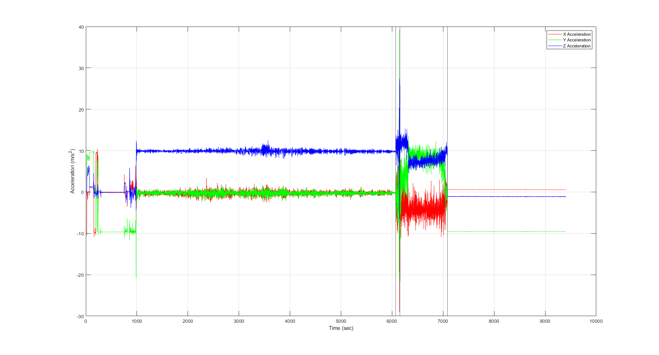
IMU accelerometer Data

Slide 10
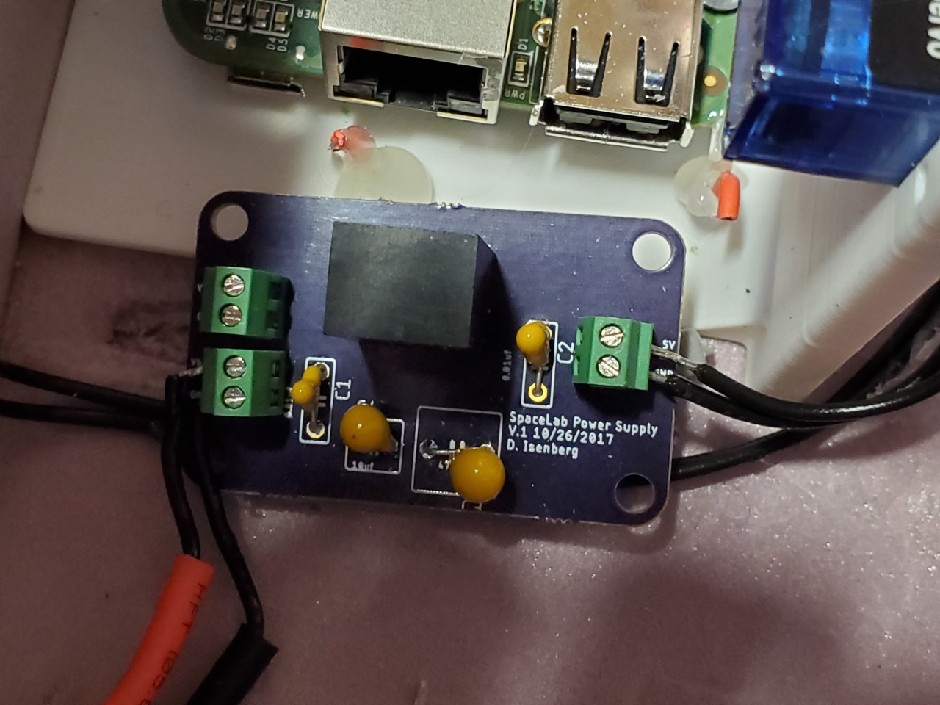
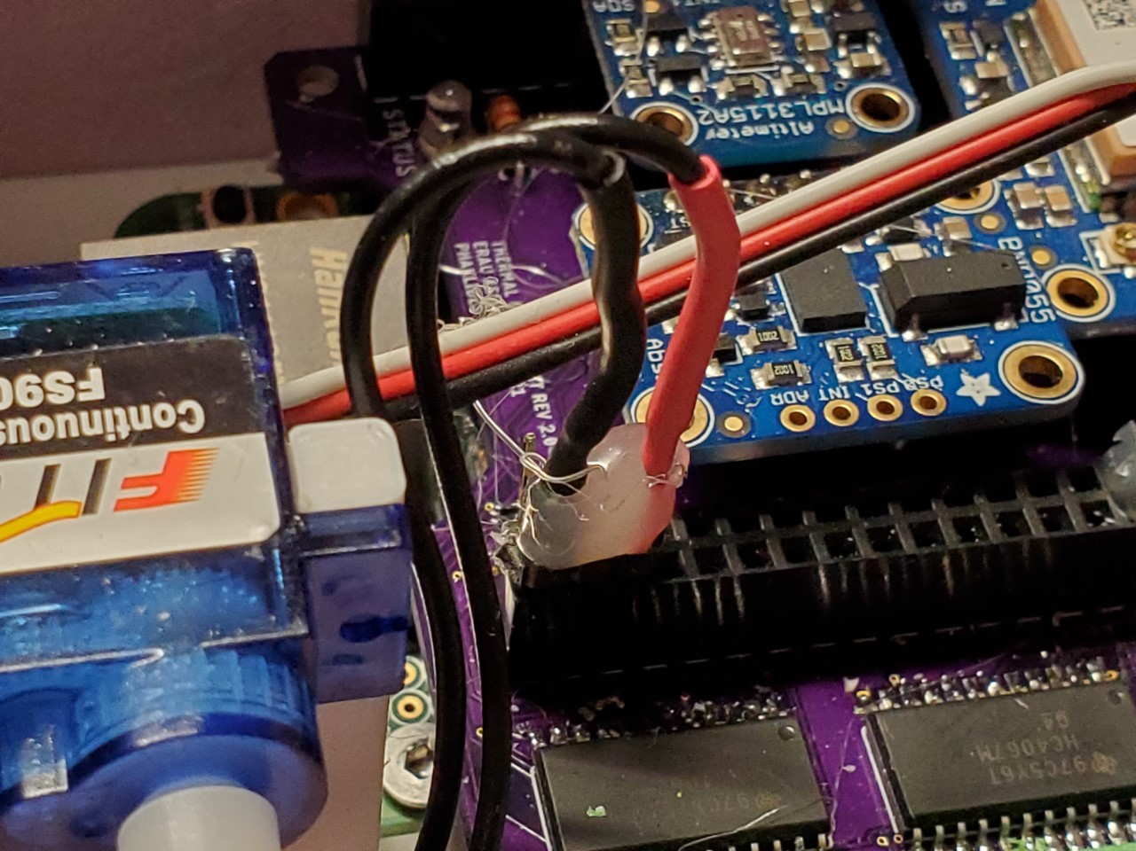
Points of failure
This meant that an exterior power supply module had to be incorporated
External power supply had to be routed into the pin header, inherently flimsy connection.
A capacitor on the power supply blew up during testing, rendering the entire module inoperable.

Slide 11
Conclusion
Overall, the payload was a success
Heat Transfer Experiment yielded good results
With enough insulation, active heating is not required
A lack of atmosphere for convection allows payloads to heat up near space
Cooling solutions are more important to focus on (high-altitude and recovery)
Failures have given important insights on
Payload structure design
PCB design
Integration
Testing

Slide 12
SPECIAL THANKS
Mentor
Dr. Douglas Isenberg
Ground Support:
Xander Pickard
Jack Crabtree
ASNR

Slide 13
Thank you!

Slide 14
ELECTRONICS and software
The payload uses a BeagleBone Green as its microcontroller
A custom PCB cape handles all of the sensors
32 analog inputs are condensed via two 16:1 MUXs into AIN0 and AIN1 of the BeagleBone
Adafruit sensors communicate via UART/I2C
Software is written in Python 3
Main loop saves all sensor data to a 32GB SD-Card every second

Slide 15
STRUCTURE
10 in by 10 in foam box
2.616lb
Thermal vent on side to cool payload when landed
Servo pulls a hole in the side
The servo is set to go off when altitude hasn’t changed and T>4hr
GoPro is imbedded into the foam
Solar panels are glued onto the exterior
Lid is attached by Velcro and nut

